Slide 1
Lesson 2 – Introduction to coding in Python and r
Dr. Jack Hong
Adjunct Faculty, Lee Kong Chian School of Business, SMU
Co-founder, Research Room Pte. Ltd.

Slide 2
Introduction to coding

Slide 3
What exactly is coding?
Coding is a tradecraft
Coding is about writing instructions to a computer
The computer follows the instructions, takes in data input, and churn out data output
A simple mathematical instruction:
Instruction: 1 + 1
Computer takes in above instruction: X + Y
Computer understands that the data input is X = 1, Y = 1
Computer returns 2
A simple logic instruction:
If 3 > 2, then return “Yes, that is correct.”, else return “No, that is wrong.”
Computer takes in the above instruction: if X > Y, then return A, else return B
Computer understands that the data input is:
X = 3; Y = 2; A = “Yes, that is correct.”; B = “No, that is wrong.”
Computer performs the logic (3 > 2) and determines that it is true
It then returns “Yes, that is correct.”

Slide 4
Coding instructions and language
A coding language is a piece of software that allows us to write instructions to a computer
There are many different languages out there, the more popular ones being:
C, C++, Java, Python, Ruby
All of them are open-source (meaning that the software is free for anyone to use, and the software is maintained by the community)
Coding principles are the same regardless of the language: master one, master all.
The main differences between the languages are:
Syntax (how instructions should be formatted)
Additional functionalities (the respective communities may decide whether a set of functions are integral to the language, and decide to create specialized syntax to invoke them natively)
Speed of execution (some languages execute instructions faster than the others)

Slide 5
Why python and R
In this course (and most data science work in general), we choose to learn about Python and R
The main reasons are:
All scientists, social scientists, engineers, and any other scientists who deals with empirical (data) work uses either or both of these languages
This implies that both languages are well supported by a large community, larger and more experienced than any software company can recruit on their payroll
This also implies that we can find the most updated and comprehensive scientific modules in these languages
Easy to find good answers to coding questions (check out stackoverflow)
Both languages are easy to learn (no awkward syntax or formatting, sufficient abstraction but not obfuscated)
Both languages are free and can be easily installed in most operating systems (Windows, Mac, Linux)
There are some “purists” out there that ridicule Python and R, and recommends C and Java
Most of their arguments are unfounded and misinformed
There are no weaknesses that we cannot correct within the Python framework, albeit with a little more effort

Slide 6
When do we use python or r?
Python is powerful enough to do anything we want, in an effective and convenient manner
However, R is more convenient when it comes to statistical packages for inference
E.g. R has modules that output all statistical results useful for inference (i.e. whether X has a significant influence on Y or not)
R has a host of specialized statistical treatments that Python does not have modules for (Python’s packages are mainly geared towards prediction, not inference)
The general workflow is thus:
Data collection, munging, exploration, and prediction in Python
Machine learning and Deep learning in Python
Export the intermediate data from Python to R for:
Statistical analysis and inference
Pretty visualizations

Slide 7
Lesson path for coding
I will orientate you to general coding principles in Python first
We will start with setting up your workspace
Instead of installing Python in your personal computer, we will access it from your browser with
Google Colab
My JupyterHub server
This implies that:
We can skip all the installation troubleshooting
You can access the programming language as long as you have an internet connection and a web browser
You will be using the server’s computational power when you execute codes

Slide 8
Introduction to coding with python

Slide 9
About python
Python comes with an extremely rich standard library (library is a collection of modules/functions)
Made even more comprehensive by a lot of high quality 3rd party packages (a package is another name for module)
We can create software for any purpose using Python
Including writing an Operating System (like windows or Mac) in Python
Python is a high-level general purpose language designed by Guido van Rossum in the late 1980s
Guido is known as the BDFL (Benevolent Dictator for Life) of Python
Guido currently spends 50% of his time at Google
The name Python was inspired from the comedy Monty Python’s Flying Circus
Python is currently, hands-down, the easiest and most powerful glue language in the coding universe
Allows coders to combine different software components together
This allows use to replace or enhance parts of Python with more powerful software (e.g. Apache Spark, Apache Kafka, Apache Storm)

Slide 10
Some Popular scientific modules in python
Numpy
Numerical computing
The foundation for all other scientific libraries
Scipy
Scientific computing
Scikit-Learn
Statistics and Machine learning
Pandas
Data munging and analysis
Keras
Deep learning

Slide 11
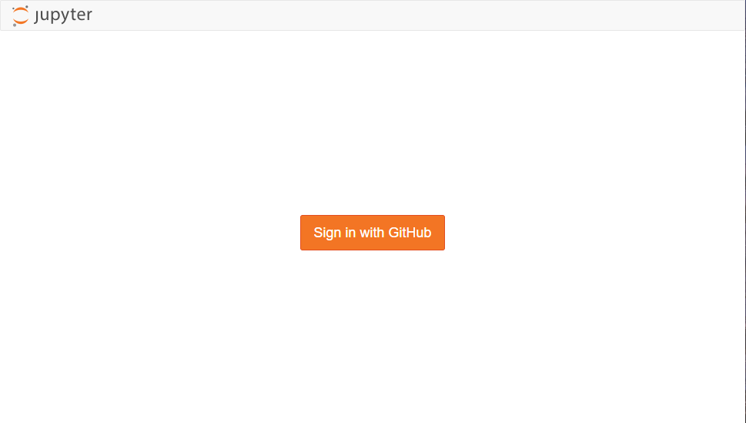
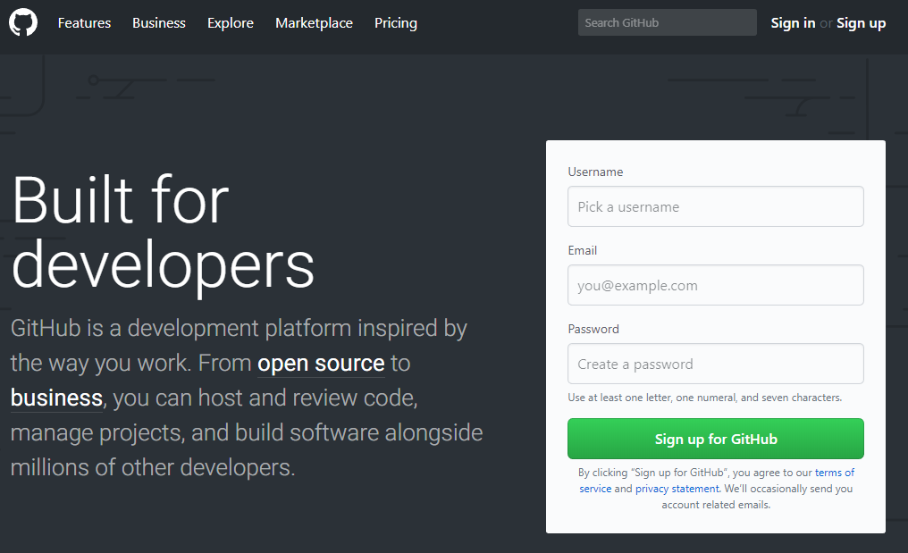
Python hands-on
We will be using the Jupyter notebook to run both Python and R codes
Option 1: You can access a Jupyter server through Google Colab
https://colab.research.google.com/
Option 2: You can access my Jupyter server
https://sumeru.io/
For the 2nd option, you will be asked to login via a GitHub account
GitHub is a team repository for codes
Most, if not all, developers will have a GitHub account
You can sign up for a free account at https://github.com
Jupyter Notebook
Github

Slide 12
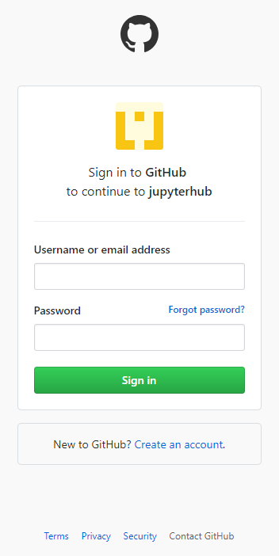
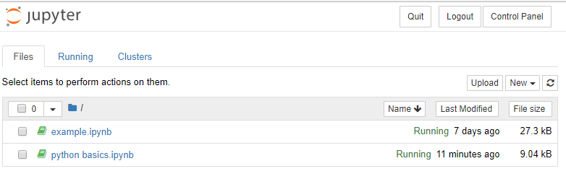
Accessing your notebook
Once you have signed in to https://sumeru.io/ using your GitHub credentials, you will be directed to your private dashboard
For Google Colab, you will also see your private dashboard with additional tutorials
Your private Jupyter Notebook Dashboard
Sign in to sumeru.io using your GitHub credentials

Slide 13
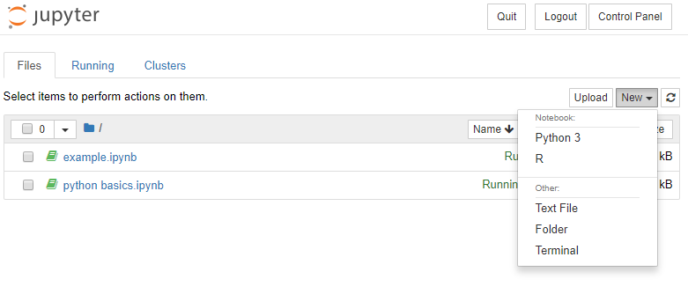
Using your dashboard
You can create new Python or R notebooks by clicking on the “New” button and choosing Python 3 or R
On Google Colab, you click on File > New Python 3 Notebook
All notebooks that you have created will be shown on your dashboard
All notebooks are automatically saved

Slide 14
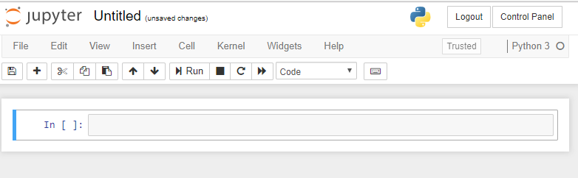
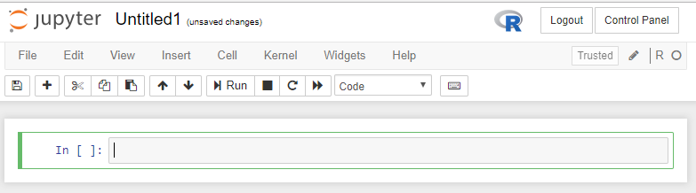
Jupyter notebooks
Once you create a new notebook, you will be presented with a coding interface for the respective language
On my JupyterHub, you can check which language the notebook is launched in by looking at the logo on the top right hand side of the browser
You can click and type to change the title of your notebook
Python
R

Slide 15
Using the notebook
Click + to add another line
Click run to execute your code (for the selected line
This is where you type your code
Jupyter notebooks are automatically saved
Codes in Jupyter notebooks are executed line by line
To select a line, simply click on it
The shortcut for executing the selected line is ctrl-enter
The shortcut for executing the selected line and created a new one underneath it, is alt-enter (windows); cmd-enter (mac)

Slide 16
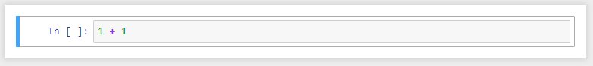
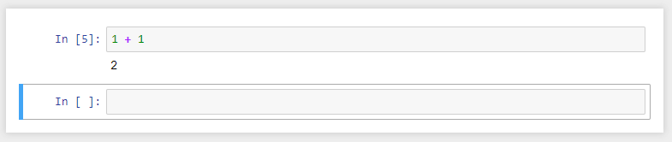
Example
Step 1: Type 1 + 1 into the first line
Step 2: Press alt-enter to execute the line and create a new one
To select a line, simply click on it
Type 1 + 1 into this line
The result 2 is given after you execute the code by pressing alt-enter
A new line is created by alt-enter as well

Slide 17
Basic coding techniques (using python)

Slide 18
Uploading sample notebook
For your first hands-on coding lesson, upload python basics.ipynb into your dashboard using the upload button
Click on the notebook title to open it
Click on the notebook title to open it
Upload python basics.ipynb using this button

Slide 19
Basic coding techniques with python
An important best practice in coding is to write comments to describe what your code does
Comments start with #
Comments will not be executed with the codes
Comments are not just meant for you, but for your team mates as well
A good piece of software typically has more comments than codes
Follow the next few slides, supplemented by the comments and codes in “python basics.ipynb”
A good way to learn about these principles is to create a new line after each demonstration and try out new values for yourself and see how it works

Slide 20
Operators
Addition: +
Subtraction: -
Division: /
Multiplication: *
Power: **
Modulo: %
modulo returns the remainder
2%2 = 0 because 2 divided by 2 has a remainder of zero
3%2 = 1 because 3 divided by 2 has a remainder of 1
Greater than: >
Greater than or equals to: >=
Less than: <
Less than or equals to: <=
Equals: ==
Not Equal: !=
Not: !

Slide 21
Data types
The 3 most common data types are:
Integers (1, 2, 3, 4, 5, …)
Float (1.2, 2.4, 5.66, 9.53432, …)
Strings (“This is a string.”)
Note that strings are enclosed in quotes “ ”
Any combination of alphabets that are not enclosed in quotes are treated as system inputs
no_of_apples is a variable
“no_of_apples” is a string (Python and R will treat it as a series of alphabet input)
Python and R treats “3” as a string, and 3 as an integer
Python and R treats “3.454” as a string, and 3.454 is a float
Any input after # is treated as comment (Python and R will not execute these when run)
Use comments extensively to document and explain your codes

Slide 22
variables
Variables are declared by assigning a value (integer, float or string), collection (list/array) or object (data.frame, regression results) to a sequence of alphanumeric characters
Note that Python and R are case-sensitive
price_of_apple = 20
Price_of_Apple = 40 (price_of_apple and Price_of_Apple are 2 different variables)
my_name = “Jack”
Behaviors
Variables can be replaced by reassigning it with another value
price_of_apple = 35 (This overwrites the previous value of 20)
Variables can be assigned to another variable, the new variable is an independent copy of the assignor
original_var = 20
new_var = original_var
When you execute new_var, you get the value of 20
When the value of original_var is changed, new_var remains unchanged at 20

Slide 23
String formatting
The print() statement is used to show the results of operations, logic, or variables in the console
When you press ctrl-enter or alt-enter, the results are shown immediately in the space below the line
Often, we want the results to be shown with some comments or information
john_apples = 40
peter_apples = 20
print(john_apples) will return 40 in the console
I can print the results with some comments like “John has 40 apples, and Peter has 20 apples” using variables instead of hardcoding the numbers
This is known as string formatting in python
The general format is string.format(variable name, variable name, ...)
“John has {} apples, Peter has {} apples.”.format(john_apples, peter_apples)
The variables in .format() will replace the {} in the string in sequence

Slide 24
collections
We always encounter collections of elements as variables in our data work
A collection of elements can be integer, float, strings, or a mix of these data types, separated by commas and encapsulated in brackets
Example: net_profit = [114.3, 98.7, 156.8, 18.3, -56.7]
There are 4 main types of collections in Python
List [] : A mutable collection (i.e. elements’ value can be reassigned)
Tuple () : An immutable collection (i.e. elements’ value cannot be reassigned, its like a locked list)
Dictionary {key: value} : An indexed collection (the value of each element can be retrieved by dictionary[key])
Set set() : A collection with only unique values

Slide 25
Subsetting collections
Elements can be extracted via subsetting [ ]
Subsetting is a practice that uses positions of elements to retrieve a slice of the collection
Note that different programming languages uses different starting index
Python uses the value of 0 for the starting index (i.e. first element in the collection), while R uses the value of 1 for the starting index
my_list = [1, 2, 3, 4]
my_list[2] will give you 3
The number in the [ ] is known as the index or position of the element in the array
List/array can be sliced using the [:] method
my_list[1:3] will give you [2, 3]
The number before : is the starting index, and the number after : is the ending index (Note that python’s slice does not include the ending index position, but R does)

Slide 26
Logic (if-Else)
If-else statements are used to return values given different conditions
if condition1:
do this
else if condition 2:
do this
else:
do this
A condition is a test of True/False or Exist/Don’t Exist statements
3 > 2 evaluates to True, 2 < 3 evaluates to False
4 in (1, 2, 3, 4) evaluates to True
5 in (1, 2, 3, 4) evaluates to False

Slide 27
Flow Control – For loop
Other than the if-else if-else statement, there are 2 important flow control methods:
For loop
While loop
Loops allow us to iterate through a collection, and perform actions on each element as we iterate
Given a list of elements, a for-loop
for n in my_list:
do this to n
Assigns the value of the first element to n (you can name this anyway you want)
Runs the block of code under the for loop
After the block is done, the for loop will then assign the value of the next element to n
Runs the block of code again (now with the value of n being that of the 2nd element)
Repeat until the list is exhausted (i.e. every element in the list has been run through once)

Slide 28
For loop
What goes on under the hood:
for n in my_list:
print(n)
Variables
my_list
41 | 15 | 6 | 56 | 34
Iteration #1
Iteration #2
Iteration #3
Iteration #4
Iteration #5
n
Procedure: print(n)
41
15
6
56
34
n is used as a variable in the procedure and takes the value of each element in my_list as the for loop iterates through the list
In the first iteration, n takes the value of the first element in my_list (41). The block of code within the for loop acts on n: print(n) -> returns 41
The block of code ends, for loop goes to the next element (15) and assigns it to n

Slide 29
While loop
Similar to a For-Loop, a While-Loop is an iteration
In a for-loop, we specify the condition as follows
for i in (1, 2, ‘Happy’, 4, 9.567):
# do this
The loop will iterate through the list c(1, 2, ‘Happy’, 4, 9.567) element by element
For each iteration, it will assign the value of the element to i
After which, it will process the block of instructions in { }
Supposed that you have 5 million elements that we wish to iterate
In this case, we may wish to use a while loop, which has the following characteristics:
The while loop will keep iterating and processing the block of instructions until the condition (in this case, i < 50) is evaluated to be False
2 important things:
Set a counter (in the e.g., i = 0 sets a counter i to 0)
After every block of instruction, increment the counter by 1
i = 0
while i < 50:
# do this
i = i + 1

Slide 30
Functions
Many a times we would want to re-use some of the instructions that we have coded before
And as we re-use the instructions for each subsequent cases, there are variable values that we would like to change
Instead of cutting and pasting the same set of codes throughout your script, and manually and painstakingly change the variable values for each case, we can create a function to improve our productivity
The other benefit of writing a function, is that we only need to amend or update the instructions (typically computation algorithms/models) once
The alternative is to find every instance of the instructions and manually cut and paste to update them
Very error prone

Slide 31
Practice questions
Variable assignment
Peter went to a fair and won 10 marbles
He played a game with Gina and lost 4 marbles
As a result, Gina has twice more marbles than Peter
She then gave 2 marbles to Tim
How many marbles does Gina have after that?
If/else
If the number of marbles that Gina has is even, print “Gina has an even number of marbles.”
If not, print “Gina has an odd number of marbles.”

Slide 32
Practice questions
Given the following lists
years = [2010, 2011, 2012, 2013, 2014, 2015]
net_profit = [27.5, -54.7, 4.6, 13.2, -25.6, 45.8]
Do the following:
Convert the above list into a dictionary
Create the following 2 functions and apply them as a list comprehension:
Returns the year in which profits were made, else 0
E.g. [2010, 0, 2012, 2013, 0, 2015]
Returns the amount of profits they needed to breakeven in a loss year
E.g. [0, 54.7, 0, 0, 25.6, 0]

Slide 33
Introduction to R Programming

Slide 34
Basics of R
The basics of R coding is very similar to the techniques we have learnt in Python in the previous segment
To start with this segment, upload “r basics.ipynb” into your dashboard
Go through the guide from the next slide onwards, supplemented with the codes in “r basics.ipynb”

Slide 35
Operators (note the difference between R and Python in Power and Modulo)
Addition: +
Subtraction: -
Division: /
Multiplication: *
Power: ** or ^
Modulo: %%
modulo returns the remainder
2%%2 = 0 because 2 divided by 2 has a remainder of zero
3%%2 = 1 because 3 divided by 2 has a remainder of 1
Greater than: >
Greater than or equals to: >=
Less than: <
Less than or equals to: <=
Equals: ==
Not Equal: !=
Not: !

Slide 36
variables
Variables in R are declared the same way as in Python
Variables in R also behave similarly
Variables can be replaced by reassigning it with another value
price_of_apple = 35 (This overwrites the previous value of 20)
Variables can be removed with the command: remove(price_of_apple)
To completely clear the memory used by this variable, execute the command: gc()
gc stands for ”garbage collector”
Variables can be assigned to another variable, the new variable is an independent copy of the assignor
original_var = 20
new_var = original_var
When you run new_var, you get the value of 20
When the value of original_var is changed, new_var remains unchanged at 20

Slide 37
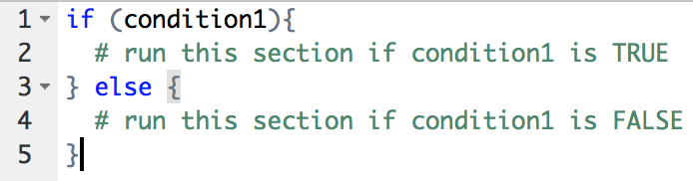
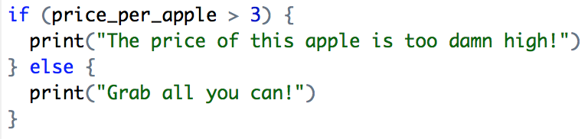
Logic (if-Else)
Simple if-else statement
A condition is a test of TRUE/FALSE statements
4 > 3 evaluates to TRUE
‘happy’ %in% c(‘I’, ‘am’, ‘so’, ‘sad’) evaluates to FALSE
try them out in the notebook
Try this out in the console as well:

Slide 38
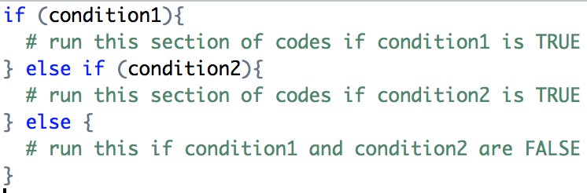
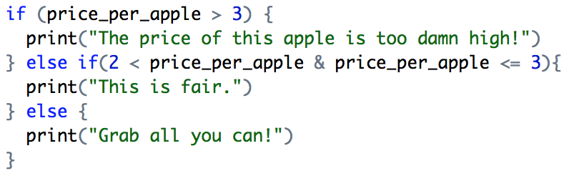
Logic (if-Elseif-else)
if-elseif-else statement
Used when our logic has more than 1 condition
The else segment will capture “everything else” that the preceding conditions fail to capture
Try this out in the console as well:

Slide 39
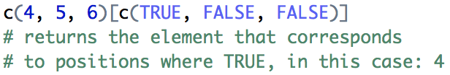
Data structures I
A collection of elements (can be integer, float or strings) is known as a list or array
In R, we specify this as c(…) and the elements are separated by commas
E.g. c(1, 2, 3, 4)
A list/array can contain mixed datatypes
c(23, “hello kitty”, 4.564) is a valid list
Single element or collections can be added together by nesting them in another c()
c(c(1, 2, 3, 4), 56) will give you c(1, 2, 3, 4, 56)
Elements can be extracted via subsetting [ ]
c(1, 2, 3, 4)[2] will give you 2
The number in the [ ] is known as the index or position of the element in the array
The first element in the array has an index of 1 (Note that python starts with 0)
List/array can be sliced using the [ : ] method
c(1, 2, 3, 4)[2:3] will give you c(2, 3)
The number before : is the starting index, and the number after : is the ending index (Note that python’s slice does not include the ending index position)
List/array can be sliced via subsetting a TRUE/FALSE array as well

Slide 40
Inbuilt Functions
Functions are commands and instructions packed into a token with parenthesis (), such as na.omit() and scatterplot()
Functions help in 2 ways:
Allows easy reusability of procedures
Allows easy replacement of values
R and its 3rd-party libraries come with tons of pre-built functions
To use a function, input your parameters into the parenthesis
E.g. for the max function, suppose we have a list of values c(3, 4, 5, 6, 7, 8)
We first assign the values to a variable called myValues
myValues = c(3, 4, 5, 6, 7, 8)
max(myValues) will return 8
Look through the R documentation (e.g. use ?max) to find out what parameters are required for the function to work as intended

Slide 41
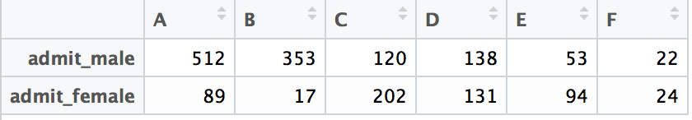
Data structures II
A dataframe looks like a table with rows and columns
While list/arrays are 1-dimensional, dataframes are 2 dimensional (rows and columns)
However, manipulating a dataframe is similar to that of a list/array
Just need to remember that we are dealing with columns in addition to rows
Dataframes can be constructed from list/arrays
Each list of values will form one column
In the above example, the dataframe is constructed by:
Dataframes can be subsetted with [row, col]
dataframe[1:1, 4:5] will return the first row with columns D and E
From the comma, omitting everything to the left will return all rows (i.e. [, 4:5]), omitting everything to the right will return all columns (i.e. [1:1, ]
Idiosyncracies that will happen if comma is omitted:
dataframe[1] will return first column
dataframe[1:2] will return first 2 columns

Slide 42
dataframes
Dataframes is the object that we will work with the most
(Suppose we have assigned the above dataframe to a variable named admit)
There are some idiosyncracies that we have to take note
We can extract a column of values from the dataframe using a single square bracket with the column name
admit[‘A’] will return the first column of values 512, 89
However, this single square bracket operation returns a dataframe
Probem 1: Some R functions (e.g. levels) cannot work with dataframe even if its only 1 column
Many other functions do not have this issue (e.g. max, sum)
Problem 2: Dataframe cannot be subsetted using a TRUE/FALSE array (but can be subsetted with a 1-column dataframe of TRUE/FALSE)
In these cases, we need to use a double square bracket [[ ]] to extract the column of values as a list/array (Note: admit$A returns list/array, not dataframe)
The difference between single and double square brackets is that the former returns a dataframe (which some functions cannot use) while the latter returns a list/array

Slide 43

Dataframe/array operations
Array and matrix operations and procedures are optimized
R and Python scientific stack processes dataframes array by array
Test of conditions between 2 array returns an array of TRUE/FALSE
Subsetting arrays with conditions returns an array of elements whose results correspond to TRUE
Array operations
Array operations
df$C
df$A
df$B
df$C
df$C
C
35
47
15
95
102
38
A
2
2
4
8
7
5
B
33
45
11
87
95
33
C
35
47
15
95
102
38
C
NA
NA
NA
NA
NA
NA
Reassigned
with NA
=
+

Slide 44
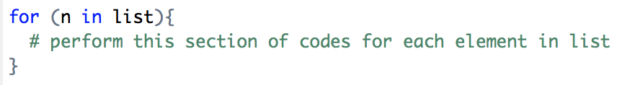
Flow Control – For loop
2 critical flow control methods:
For loop
While loop
For Loop
Given a list of elements, a for-loop
Assigns the value of the first element to n (you can name this anyway you want)
Runs the section of code (if the variable n is used in this set of codes, it will use the value of the first element)
After it is done with the section of code { }, it will then assign the value of the next element to n
Runs the section of code again (now with the value of n being that of the 2nd element)
Repeat until the list is exhausted (i.e. every element in the list has been run through once)

Slide 45
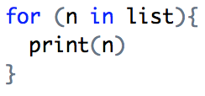
For loop
The code:
What goes on under the hood:
Variables
list
41 | 15 | 6 | 56 | 34
Iteration #1
Iteration #2
Iteration #3
Iteration #4
Iteration #5
n
n is used as a variable in the procedure
Procedure: print(n)
41
15
6
56
34

Slide 46
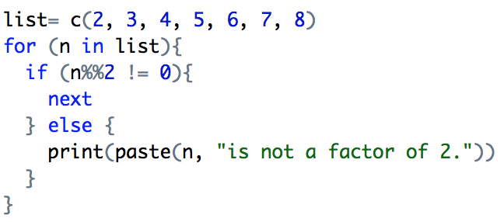
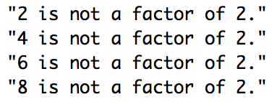
For loop
We often integrate if-else with for-loop as well
If we want to use an if-else statement on multiple variables, and do not want to code the same set of if-else statement for each variable (which will result in a lengthy set of codes that keeps repeating itself)
Sometimes we want to keep the results of the executed procedures on some elements but not others
Use the ”next” command to proceed to the next element in the list without going through the rest of the code
For-loops can be nested as well, often used in cases when we want to get all the interacted results from 2 or more lists
Assign the array of values to the variable list
If the remainder of n / 2 is not 0, ignore the rest of the code and start again with the next element in list
Results in console:

Slide 47


While loop
Similar to a For-Loop, a While-Loop is an iteration
In a for-loop, we specify the condition as follows
The loop will iterate through the list c(1, 2, ‘Happy’, 4, 9.567) element by element
For each iteration, it will assign the value of the element to i
After which, it will process the block of instructions in { }
Supposed that you have 5 million elements that we wish to iterate
Our computer’s ram will be reduced by a large amount if we load the elements into a list and applying a for-loop
In this case, we may wish to use a while loop, which has the following characteristics:
The while loop will keep iterating and processing the block of instructions until the condition (in this case, i < 50) is evaluated to be FALSE
2 important things:
Set a counter (in the e.g., i = 0 sets a counter i to 0)
After every block of instruction, increment the counter by 1

Slide 48
Brackets in R
()
Round brackets are used to encapsulate arguments (including conditions)
E.g. for function max, it takes a list as an argument and returns the largest value in the list
max(args), where args = arguments
E.g. for if-else statements, where we specify a condition
if (a == 6){do this}
{}
Curly brackets are used to encapsulate a block of instruction
E.g. for if-else statements: if (a ==6) {do this}
Curly brackets allow you to write multiple lines within the block

Slide 49
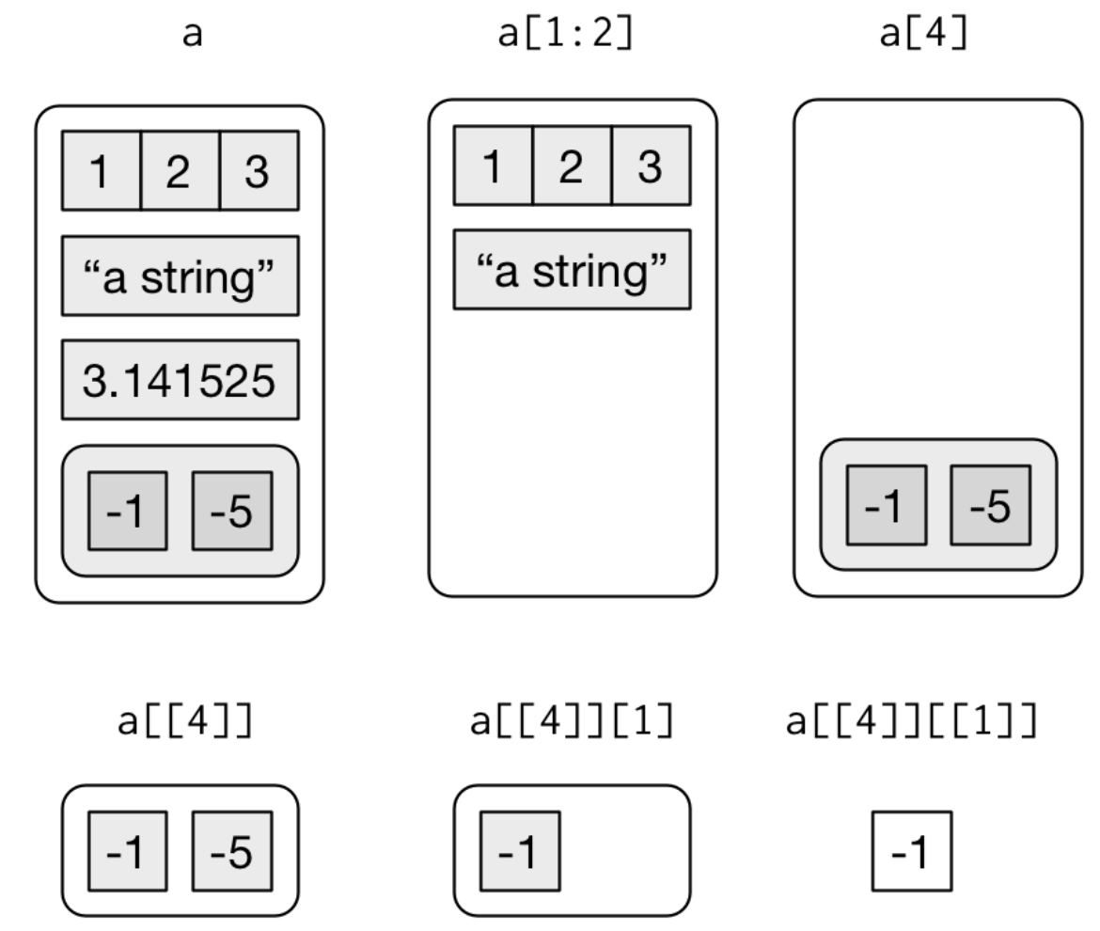
Brackets in R
[ ] Square brackets are used for subsetting data objects (such as list and dataframes)
R abstracts the [] operation by allowing two methods
[pos] returns the element in the data object by its position in the object (e.g. c(1, 0, 4, 5)[3] returns the value of the 3rd element: 4)
[row, column] returns a slice of the data object specified by start:row (e.g. [1:3,] returns rows 1 to 3 with all columns) Note: empty value implies return all
Note that [] returns elements, so if a list is nested (e.g. list(c(1, 2, 3, 4), c(5, 6, 7, 8))), then [1] will return the value of the first element which is c(1, 2, 3, 4)
[[ ]] Double square brackets are used to extract a single component from a list AND REMOVES THE HIERARCHY
This means that if used on a dataframe (e.g. df[[gender]]), it will return a list of values for the column gender.
The shorthand for this is $ (e.g. df$gender is the same as df[[gender]])

Slide 50
Functions I
Many a times we would want to re-use some of the instructions that we have coded before
And as we re-use the instructions for each subsequent cases, there are variable values that we would like to change
Instead of cutting and pasting the same set of codes throughout your script, and manually and painstakingly change the variable values for each case, we can create a function to improve our productivity
The other benefit of writing a function, is that we only need to amend or update the instructions (typically computation algorithms/models) once
The alternative is to find every instance of the instructions and manually cut and paste to update them
Very error prone

Slide 51


Functions II
We have been using inbuilt functions in R
max() is such a function, which returns us the element with the largest value
max(c(4, 3, 7, 6, 4, 5, 7, 9)) returns 9
The basic format of a function is as follows:
Declare a function name (function_name) as a variable
Assign it with a function object (function())
Depending on the variables that you want to use in the block of instructions, you can name them as arguments (you can have tons of them if you need)
A return statement to specify the result of the function (in the above instance, running the function will return the difference between start and end
Calling the function is simply putting in the arguments and executing it (in this case, function_name(4, 8) will return a value of 4)

Slide 52
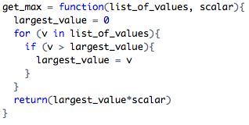
Functions III
Let’s try building a custom max function
We want this function to return the largest value of a list, and multiply it by a scalar
The list and scalar can differ in all our cases
The setup:
Name the function as get_max
Specify the arguments (in this case 2: list_of_values and scalar)
These will be referenced in the block of instructions to return different results from different arguments
The logic
Create a variable (largest_value) to store the largest value, set the initial value to 0
Use a for loop to iterate through the argument (list_of_values)
Replace largest_value with the element’s value if it’s larger than the existing value of largest_value
Once the iteration is complete, we would have the largest value in the list
Before returning the result, we multiply largest_value by the scalar

Slide 53
Additional comments

Slide 54
additional comments
Familiarize yourself with the basic characteristics of what was covered
Need to know what goes on under the hood
Datatypes and collections
Techniques and idiosyncracies
Subsequently, its all about how you exercise your creativity to get the results you want
Practise, practise and practise!
Upload “r exercises.ipynb” and try out the exercises

Slide 55
Questions?
Email any queries to
jackhong@smu.edu.sg

